Slide 1
String variables and asking user to enter an input
input

Slide 2
Two way conversations allow you to do more with computers.
Websites need your address and payment information to ship products to your home.
Insurance companies need information to calculate how much premium you need to pay.
Calculators need you to enter numbers to do the required calculation.

Slide 3
How can we ask a user for information?
name = input(“What is your name”)
The input function allows you to display a message and returns the value typed in by the user.
We use a variable to remember the value typed by the user.
We called the variable name, but you can call it anything as long as it does not contain spaces.

Slide 4
Demo
Asking user for an input

Slide 5
Where do we store values?
Variables

Slide 6
Variable
Think of a variable as a box that stores something and can be retrieved later when it is needed.
name =
Shiva

Slide 7
Variable
If you need to remember more than one variable, create one more ... .
name Marital status Food
Shiva
Single
Non-veg

Slide 8
If you want to access the variable later,you can ..
# Asking for user input
name = input(“Your name?”)
# prints the user name
print(name)

Slide 9
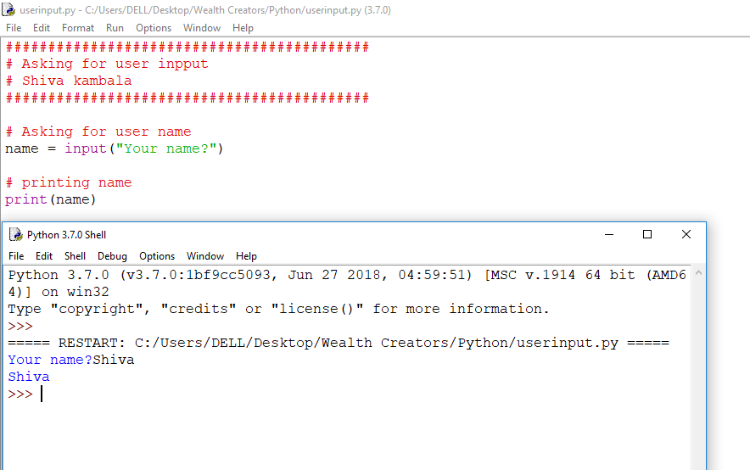

Slide 10
If you want to change the value of the variable later,you can ..
# Asking for user input
name = input(“Your name?”)
# prints the user name
print(name)
name = “Mahesh”
print(name)

Slide 11
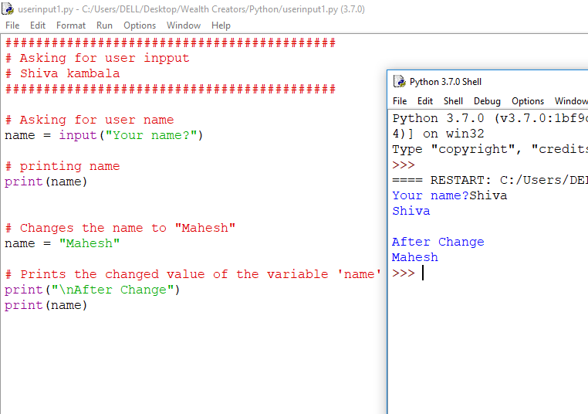

Slide 12
Variable names
Rules and Guidelines:

Slide 13
Variable names
Rules:
- Can not contain spaces
- Are case sensitive
- firstName and firstname would be two different variables.

Slide 14
Variable names
Guidelines:
- Should be descriptive but not too long(‘favoriteSign ‘ but not ‘yourFavoriteSigninTheMovie’)
- Use a casing scheme
(camelCase or PascalCase)

Slide 15
Which of the following do think would be the valid variable names??
Variable1
First Name
Date
3Name
DOB
DateOfBirth
YourFavoriteSignInTheHoroscope

Slide 16
Manipulating variables
With + operator

Slide 17
You can combine variables and strings with the + symbol
firstName = “Shiva”
lastName = “Kambala”
print(“Hello ” + firstName + lastName)

Slide 18
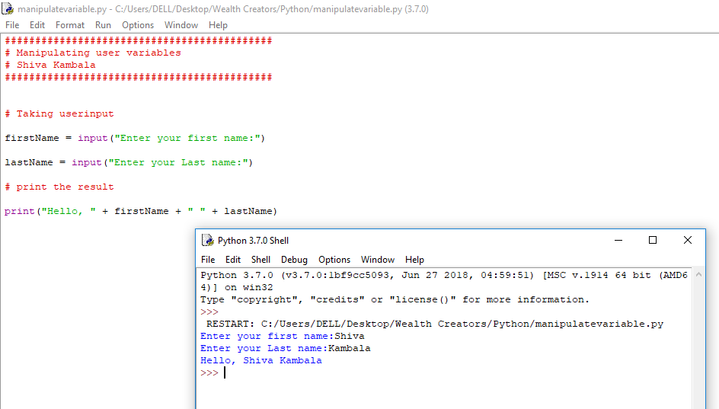

Slide 19
Often you need to add punctuations or spaces to format the ouput

Slide 20
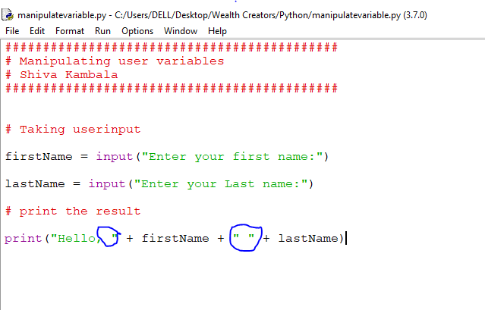

Slide 21
Now you can create a story teller program
animal = input(“Your favourite animal:”)
building = input(“Name a famous building:”)
color = input(“Your favourite colour:”)
print("Hickory Dickory Dock!“)
print("The "+color+" "+animal+" ran up the "+building)

Slide 22
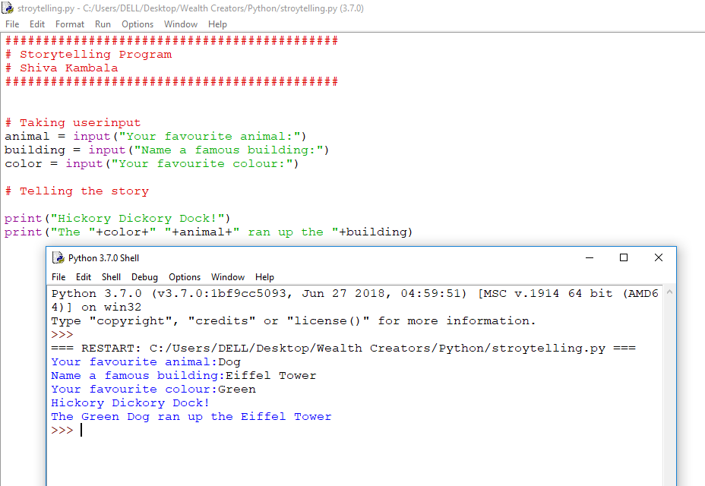

Slide 23
Variables also allow you to manipulate the contents
messege = “Hello world”
print(message.lower())
print(message.upper())
print(message.swapcase())

Slide 24
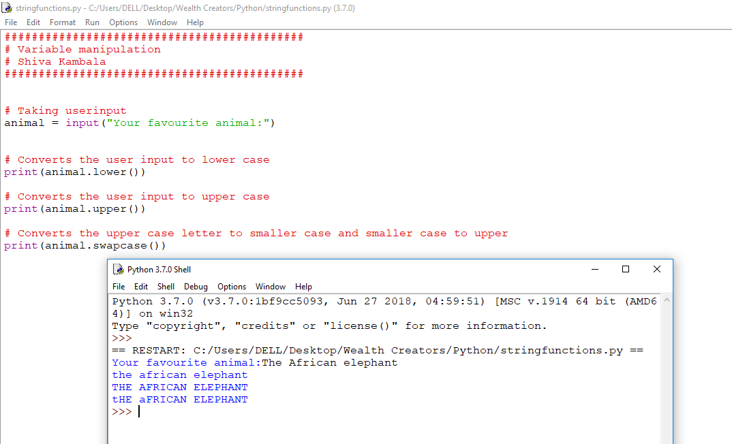

Slide 25
Geek tip!
lower,upper and swapcase are different string fucntions.
Because we storing a string in a variable, we can use any string function to manipulate the variable.

Slide 26
What do you thing these functions will do?
message = “Hello world”
print(message.find(‘world’))
print(message.count(‘o’))
print(message.capitalize())
print(message.replace(‘Hello’, ‘hi’))

Slide 27
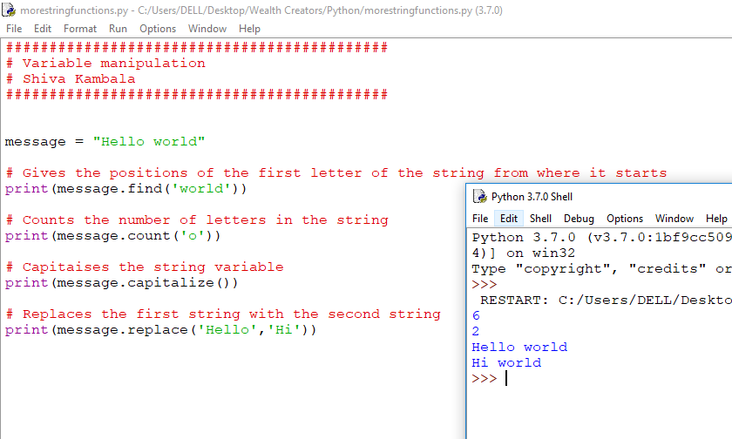

Slide 28
Programmers do not memorise all these functions
IntelliSense
Interent searches
Referring to the documentation

Slide 29
Initialize variable...........
Our program do not know what we are going to store in our variable.
A good habit in programming is to intialize your variable . It means you give initial value when you create it.
name = “ ”
name = input(“Enter your name:”)

Slide 30
Functions and variables allow us to make new mistakes in our code....
Each line of code below has a mistake.
message = Hello world
23message = 'Hello world'
New message = 'Hi there'
print(message.upper)
print(mesage.lower())
print(message.count())

Slide 31
Functions and variables allow us to make new mistakes in our code....
Mistakes:
message = 'Hello world'
23message = 'Hello world'
New message = 'Hi there'
print(message.upper())
print(message.lower())
print(message.count('H'))

Slide 32
Your Challenge
Write a program that allows a person to personalize a story
Take a page from a book or make up a story. Ask the user to enter information you can replace in the story such as their name, a place, or insert adjectives or adverbs into the story. Then display the personalized story to the user
For extra credit make sure you correct anything they type in with the incorrect case (e.g. if they type an adjective in uppercase you may want to display it in lowercase)

Slide 33
Congratulations!
You can now write a computer program that can interact with the user.

